Slide 1

EXPENSE MANAGEMENT SYSTEM SPRINT 1 (EMPLOYEE FUNCTIONALITIES)
BATCH 3 TEAM 1
UNDER THE GUIDANCE OF :
ARUNA VANGALA
-HASINI
-CHINMAI
-KAVYA SRI
-BHARGAVI
-VYSHNAVI TEJASWITHA​​

Slide 2

Project Description
Expense management not only tracks employee spending but also determines how the organization will reimburse the costs incurred.
It also applies the procedures and policies used to control this type of spending.

Slide 3
Project Description
For example, if employees are given daily allowances for meals when traveling, then the expense management process accounts for those limits when generating reimbursements for workers.

Slide 4
Types Of Expenses In Our Project
Travel Expense
Relocation
Food Expense
Internet

Slide 5
Plan Of Action
DAY 1
Work Flow Discussion
User Stories,
Empathy maps,
Wire frames
DAY 2
React Login page
Spring Rest Backend for login page
DAY 3
Employee Dashboard & Expense Form Creations
Backend Spring Rest for Employee Dashboard

Slide 6
DAY 4
Security Authentication
Configuring Expense Status
DAY 5
Presentation
Sprint 1 review preparation

Slide 7

User Stories​
User Story Id - 01
Use case- Employee Login
Description- Employee should be able to login with their credentials.
Acceptance Criteria-
After successful login, should be redirect to dashboard page.
If login is failed, should redirect to login page with invalid credentials message.

Slide 8
User Stories​
User Story Id - 02
Use case- Employee Dashboard
Description- In Employee dashboard , I should be able to create expenses
Acceptance Criteria-
After redirecting to employee dashboard , profile with the name should be displayed
Create expense button should help create a expense.

Slide 9
User Stories​
User Story Id - 03
Use case- Type Of Expense
Description- Should be able to select the type of expense
Acceptance Criteria-
After selecting the type of expense , should be able to submit the expense related receipts.

Slide 10
User Stories​
User Story Id - 04
Use case- Status Of Expense
Description- Should be able to view the status of expense
Acceptance Criteria-
After submission of receipt , should be able to see status of expense whether it is approved or rejected or is in pending state.

Slide 11
User Stories​
User Story Id - 05
Use case- Commenting their views
Description- Should be able to comment on the submitted expense
Acceptance Criteria-
After submission of receipt , should be able to mention views on the comments section which results in manager to see and know the employee views

Slide 12
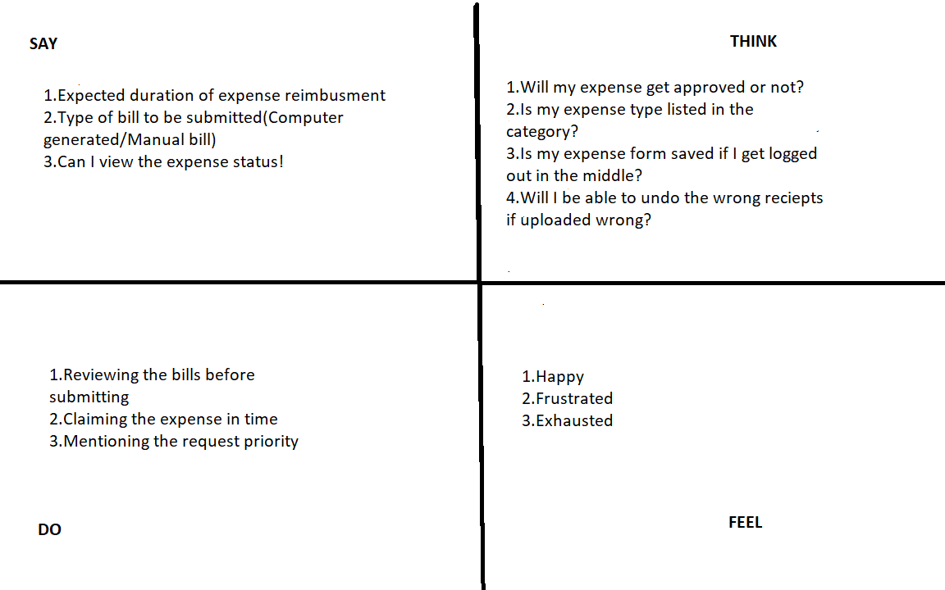
Empathy Map
​
​

Slide 13
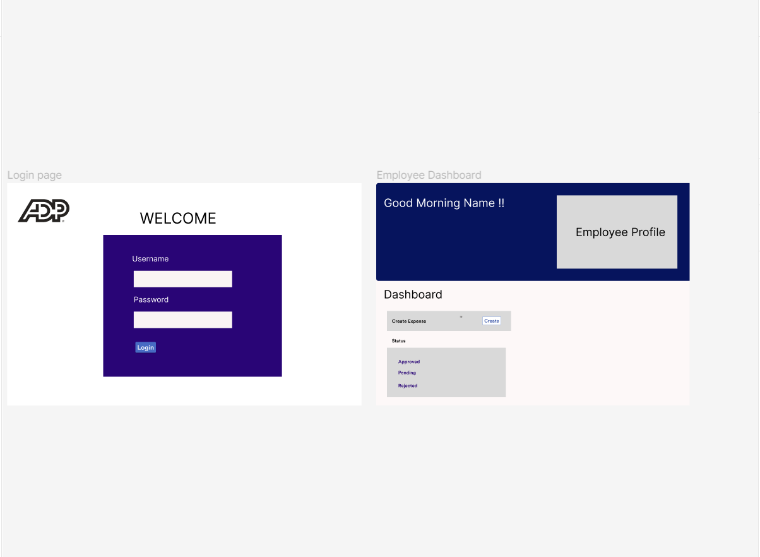
Wire Frames
​
​

Slide 14
Journey Map
PAINS | GAINS
Claiming expense manually by submitting bills Couldn’t claim type of expenses, for example Travel, Internet , Food , Relocation separately. Facing challenges while claiming the expense | User friendly interface Easy to claim expenses Able to access and complete claiming expense in minutes
​
​

Slide 15

Database Structure
There are 2 tables related to our project
​

Slide 16
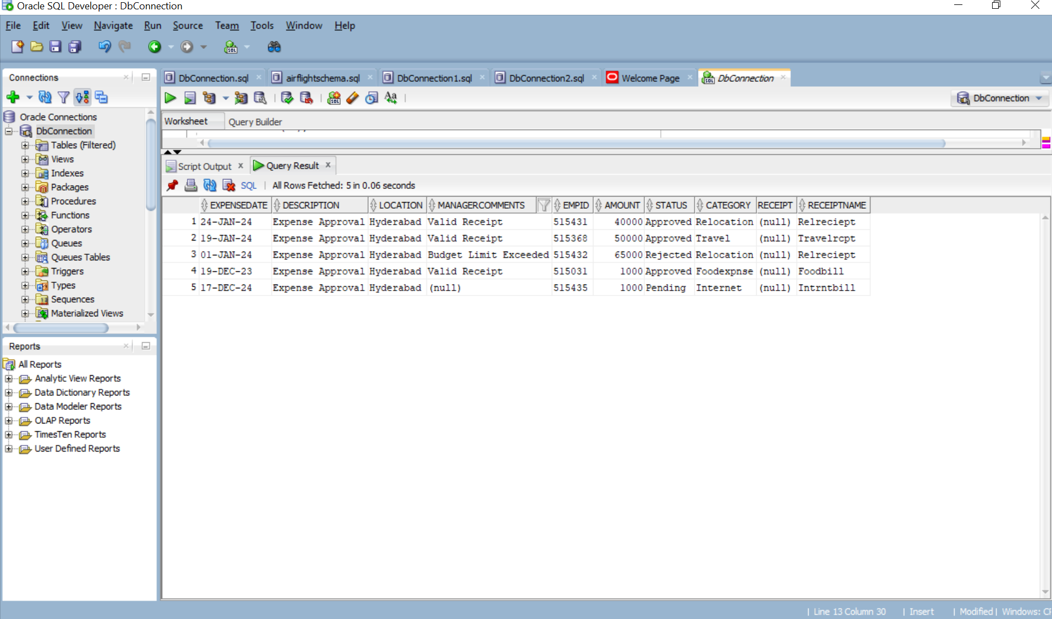
EXPENSE TABLE @Table(name=“Expenseb3team1”)

Slide 17
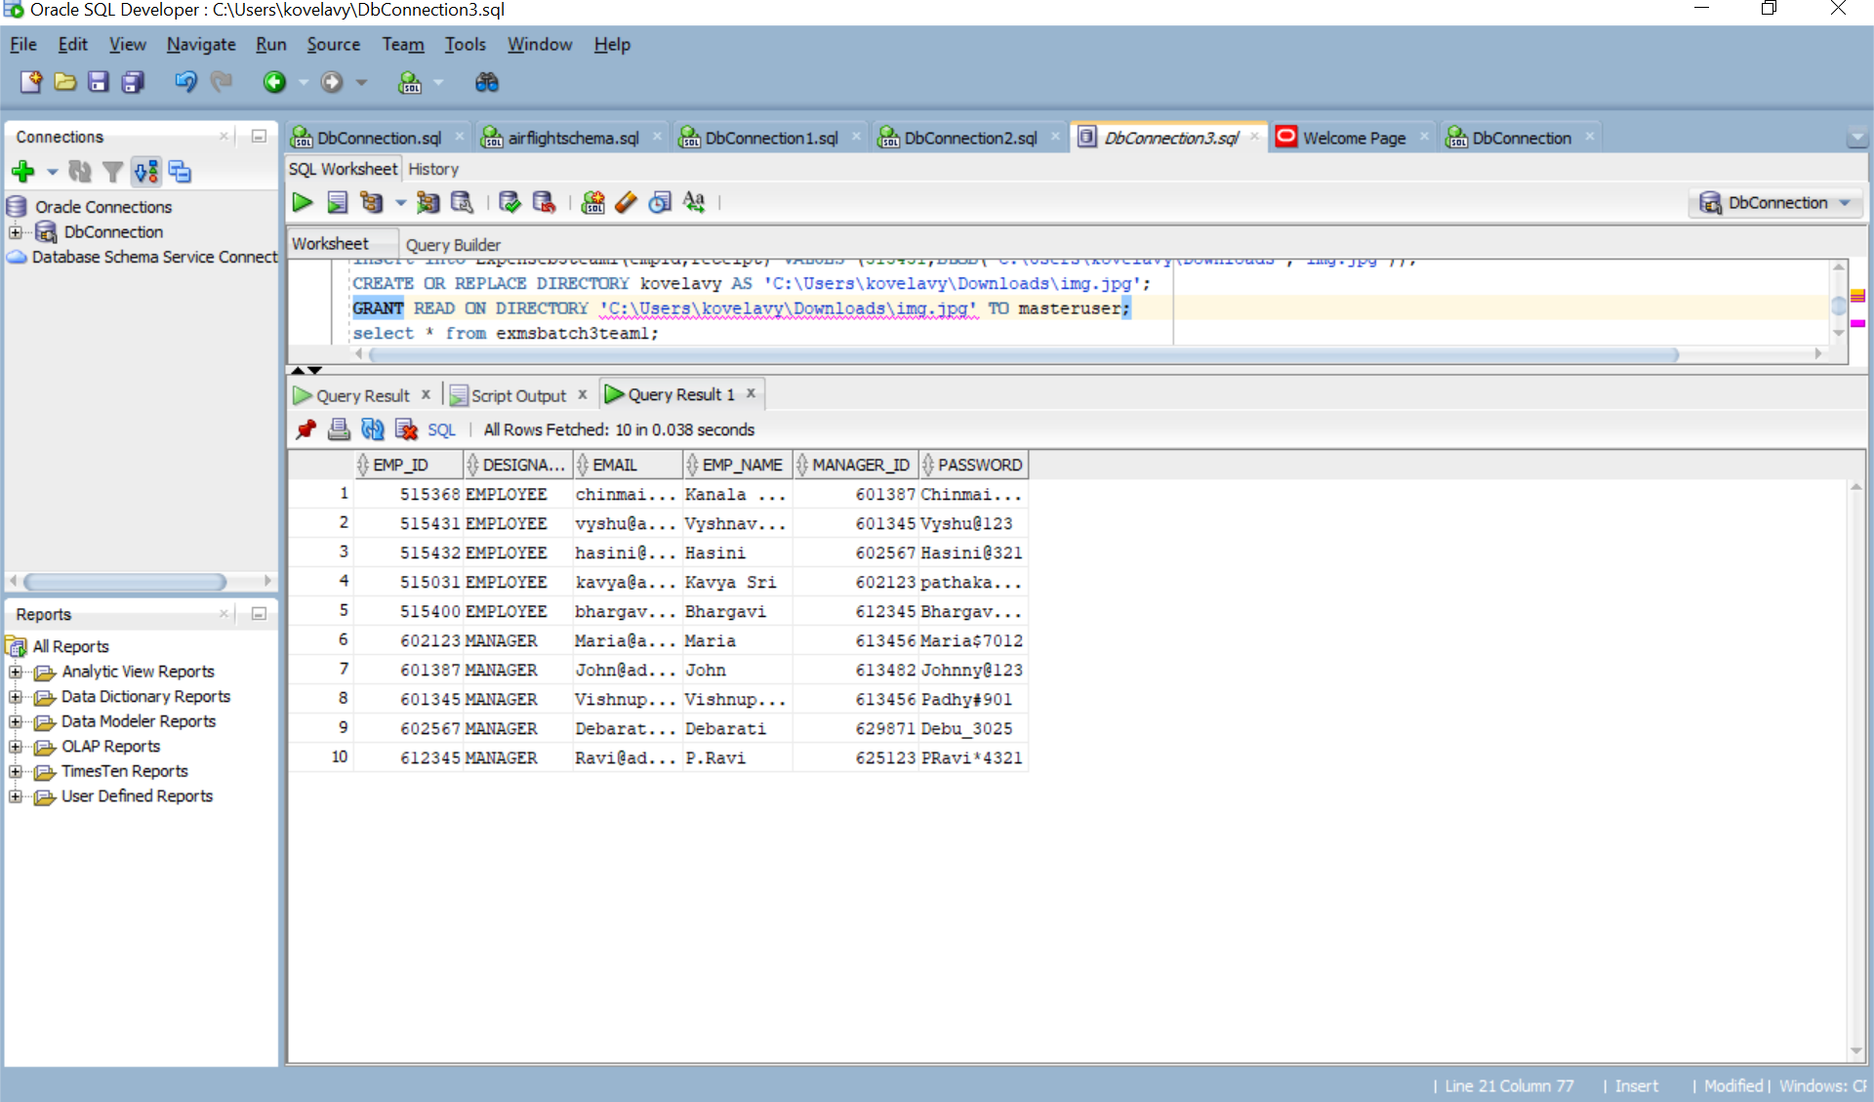
EMPLOYEE TABLE @Table(name=“exmsbatch3team1”)

Slide 18
EXPENSE MANAGEMENT SYSTEM SPRINT 2 (MANAGER FUNCTIONALITIES)

Slide 19
Plan Of Action
DAY 6
Advancement of employee dashboard
Methods for manager dashboard in SpringREST
DAY 7
Designing manager dashboard components
Spring Rest Backend for login page and validations
DAY 8
Manager insights and expense List frontend , backend
Backend and frontend integration

Slide 20
DAY 4
Junit Testing
Dockerization and Jenkins pipeline testing
DAY 5
Presentation
PPT preparation

Slide 21
User Stories​
User Story Id - 01
Use case- Manager Login
Description- Manager should be able to login with their credentials.
Acceptance Criteria-
After successful login, should be redirect to dashboard page.
If login is failed, should redirect to login page with invalid credentials message.

Slide 22
User Stories​
User Story Id - 02
Use case- Manager Dashboard
Description- In Manager dashboard , I should be able to create expenses as even I am a employee
Acceptance Criteria-
After redirecting to manager dashboard , profile with the name should be displayed
Create expense button should help create a expense.

Slide 23
User Stories​
User Story Id - 03
Use case- Expense List
Description- Should be able to view expenses mapped to the manager
Acceptance Criteria-
After viewing the expense, should be able to approve or reject the expense related receipts.

Slide 24
User Stories​
User Story Id - 04
Use case- Approve Or Reject Expense
Description- Should be able to approve or reject the expense
Acceptance Criteria-
After clicking expense list , should be able to Approve or Reject the expense

Slide 25
User Stories​
User Story Id - 05
Use case- Commenting their views
Description- Should be able to comment on the submitted expense
Acceptance Criteria-
After viewing the receipt , should be able to mention views on the comments section where employees can see why the expense is rejected

Slide 26
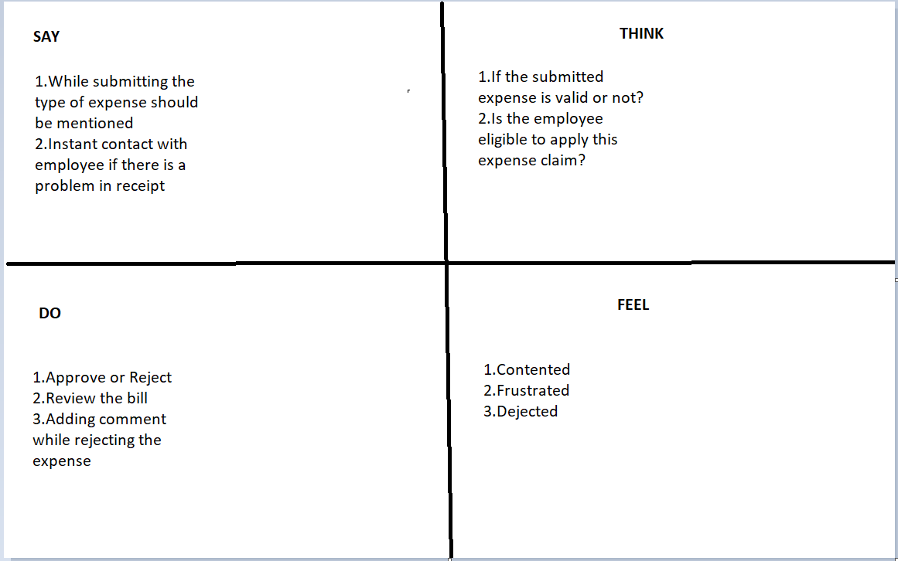
Empathy Map
​
​

Slide 27
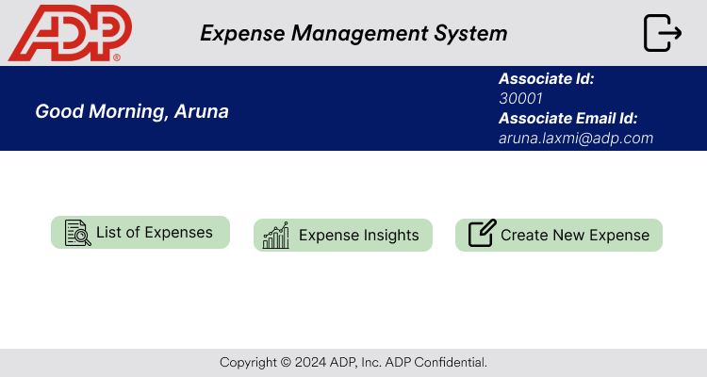
Wire Frames
​
​

Slide 28
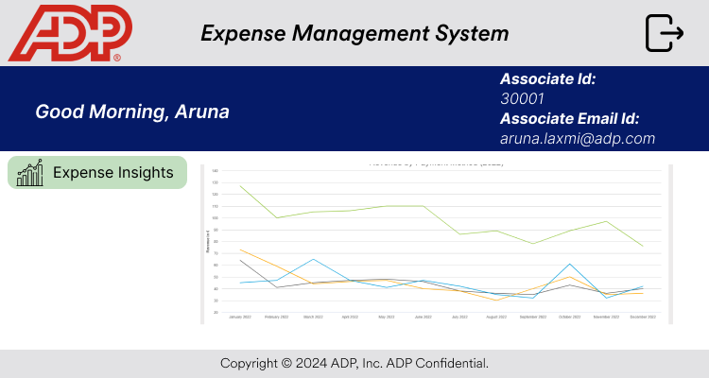
Wire Frames
​
​

Slide 29
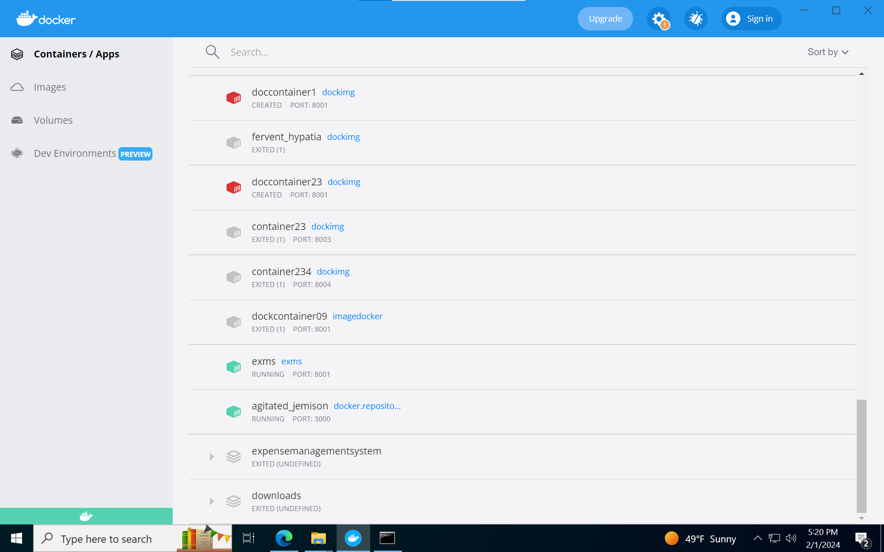
Dockerization FrontEnd
​
​

Slide 30
Dockerization BackEnd
​
​

Slide 31
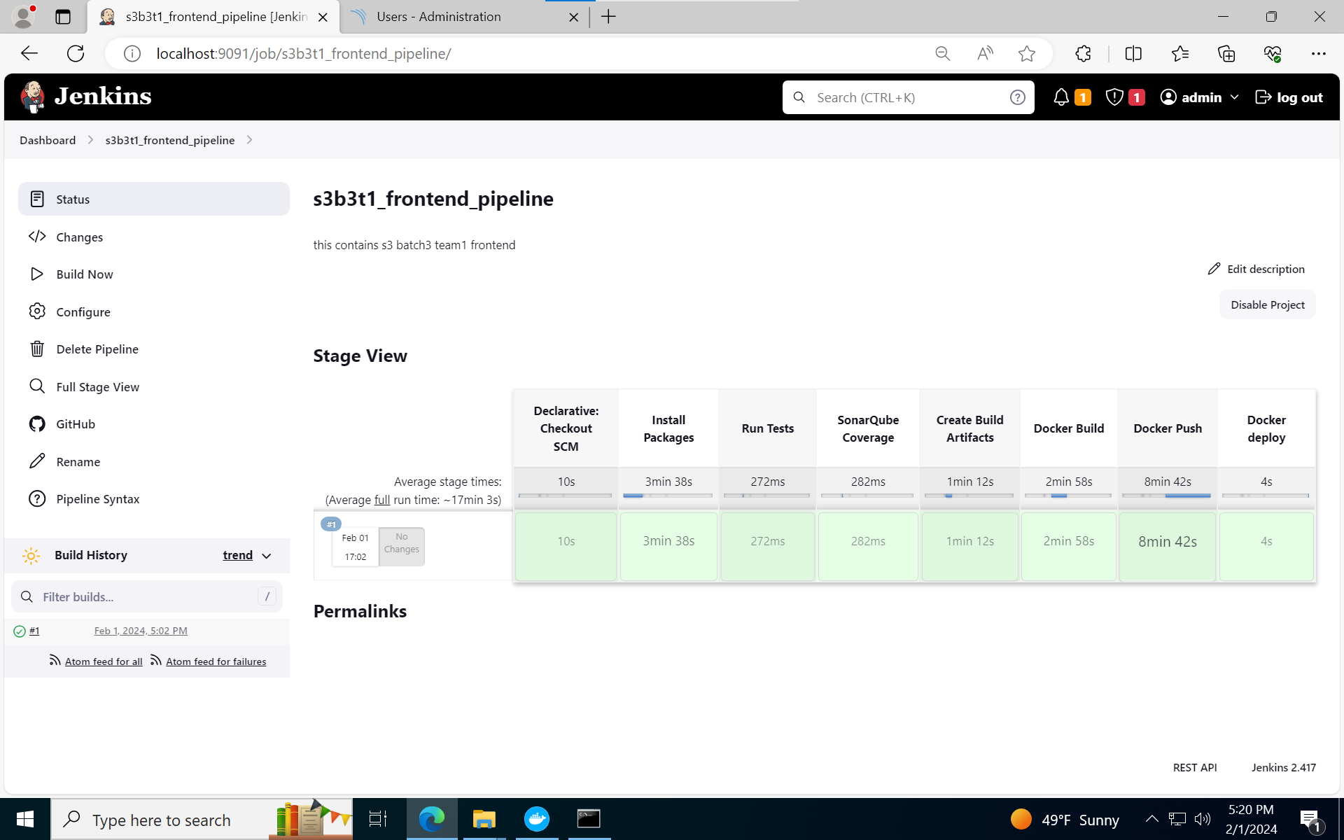
Jenkins Pipeline Front End
​
​

Slide 32
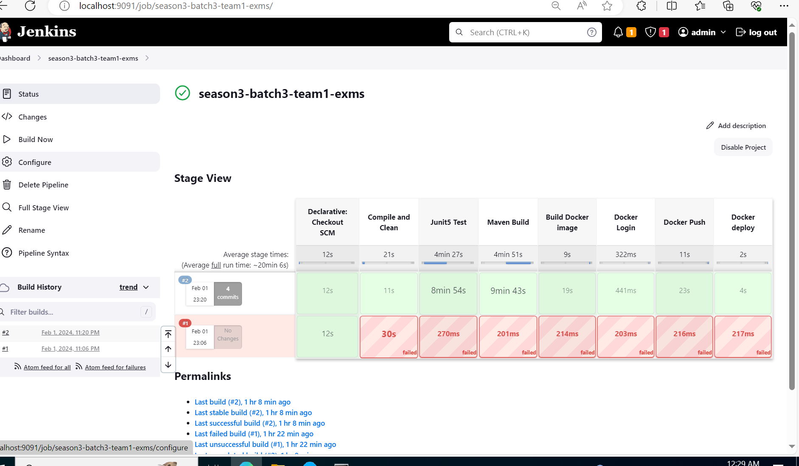
Jenkins Pipeline Back End
​
​

Slide 33
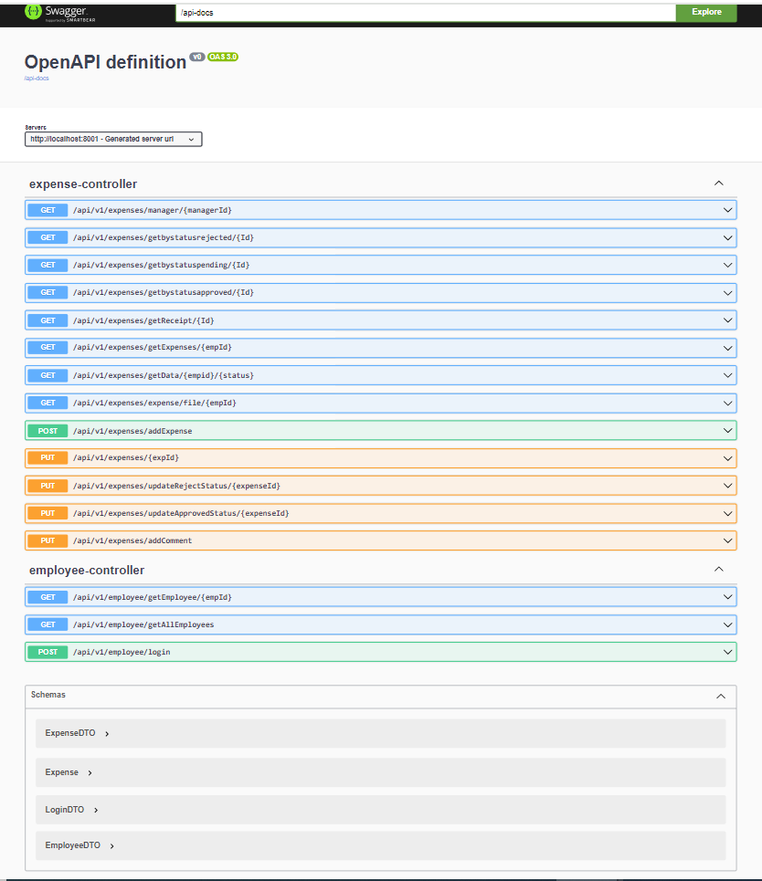
SWAGGER
​
​

Slide 34


​
Thankyou!​

